Slide 1

Exchange and Correlations Functionals
Slides copied in entirety from:
Neeraj Rai
^{neerajrai@che.msstate.edu}
Dave C. Swalm School of Chemical Engineering and Center for Advanced Vehicular Systems, Mississippi State University, USA

Slide 2
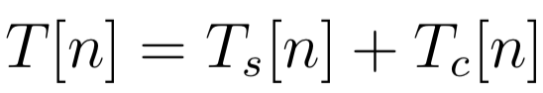
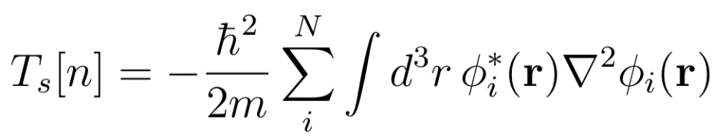
Exchange-correlation functional
Write down total kinetic energy functional as the sum of non-interacting particle density (n) and the one that represents rest of the kinetic energy functional
where,
We rewrite the exact energy functional as:
Capelle, Brazilian Journal of Physics, 36, 1318-1343, 2006
neerajrai@che.msstate.edu

Slide 3
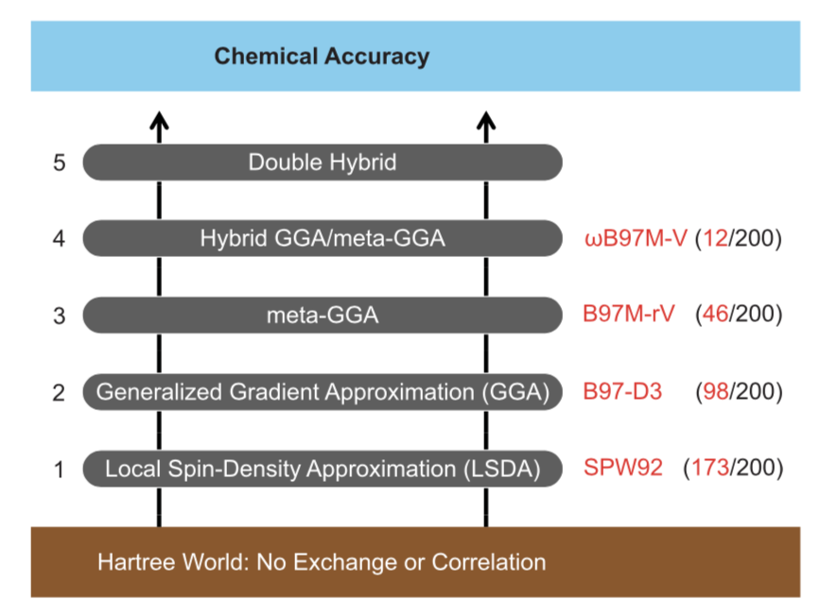
Perdew’s Jacob’s ladder
Mardirossian and Head-Gordon, Mol. Phys., 115, 2315-2372, 2017
neerajrai@che.msstate.edu

Slide 4
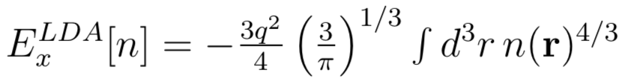
Local density approximation (LDA)
Exchange Functional (based on the exact exchange energy of homogeneous electron system):
The correlation functionals are parameterized against quantum Monte Carlo results for uniform electron gas. The overall exchange-correlation functional is of the form:
Success of LDA is primarily due to the cancellation of errors (E_{X} is overestimated while the E_{C} is underestimated]
Capelle, Brazilian Journal of Physics, 36, 1318-1343, 2006
neerajrai@che.msstate.edu

Slide 5
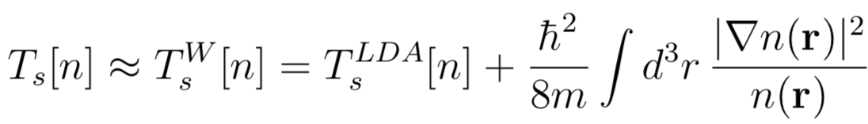
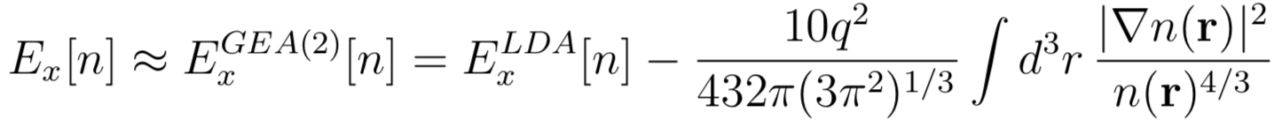
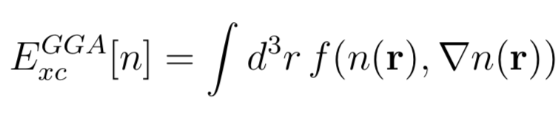
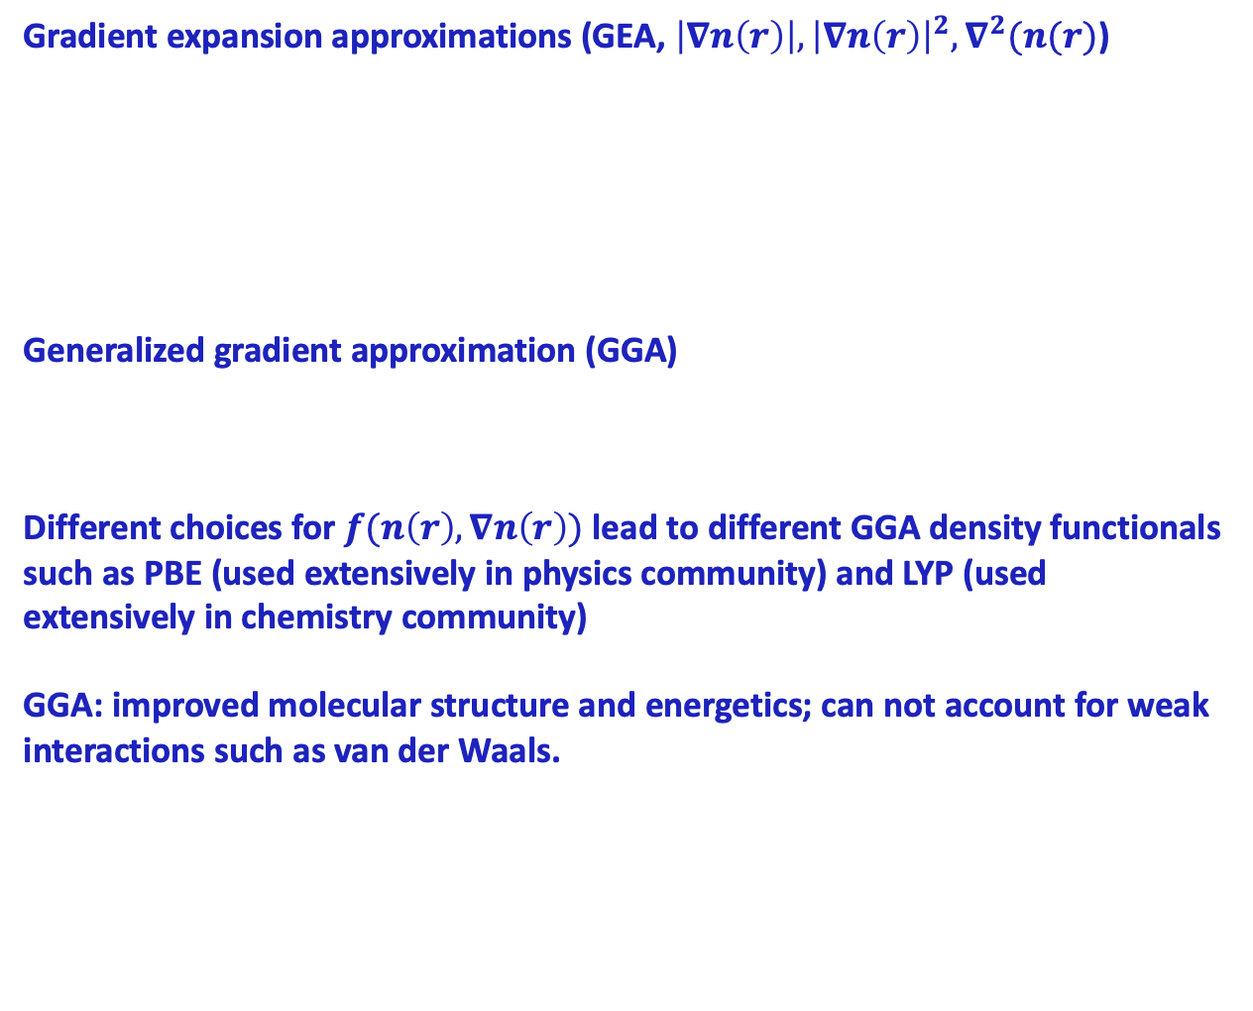
Semilocal functionals
Gradient expansion approximations (GEA, $\left|∇n\left(r\right)\right|,{\left|∇n\left(r\right)\right|}^{2},∇^{2}(n(r)$)
Generalized gradient approximation (GGA)
Different choices for $f(n\left(r\right),∇n\left(r\right))$ lead to different GGA density functionals such as PBE (used extensively in physics community) and LYP (used extensively in chemistry community)
GGA: improved molecular structure and energetics; can not account for weak interactions such as van der Waals.
Capelle, Brazilian Journal of Physics, 36, 1318-1343, 2006
neerajrai@che.msstate.edu

Slide 6
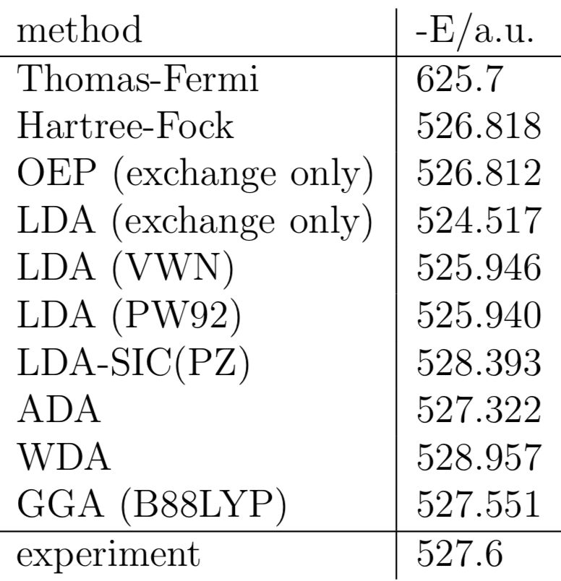
Comparison of different LDA and GGA functions
Ground state energy of the argon atom in atomic units (Hartree)
Capelle, Brazilian Journal of Physics, 36, 1318-1343, 2006
neerajrai@che.msstate.edu

Slide 7
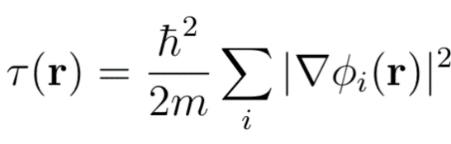
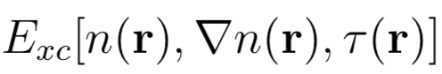
Meta-GGA functionals
Exchange-correlation functional depends not only on the density, gradient of the density but also on the Kohn-Sham kinetic energy density
The additional degree of freedom is used to satisfy:
self-interaction corrected correlation functional
recovery of fourth order gradient expansion for the exchange
finite exchange potential at the nucleus
Capelle, Brazilian Journal of Physics, 36, 1318-1343, 2006
neerajrai@che.msstate.edu

Slide 8
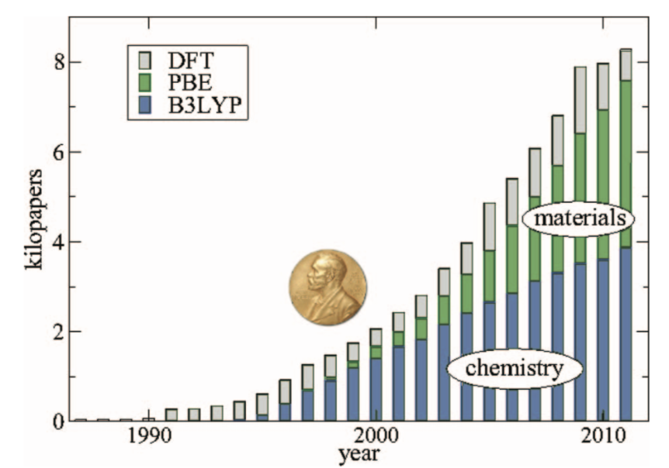
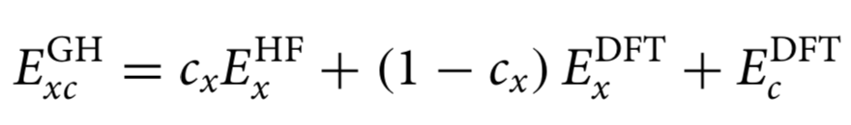
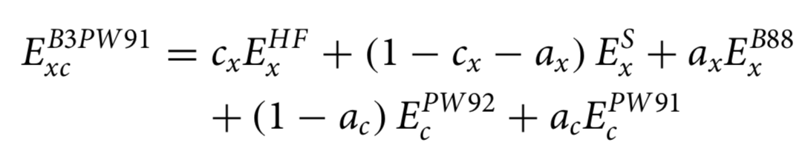
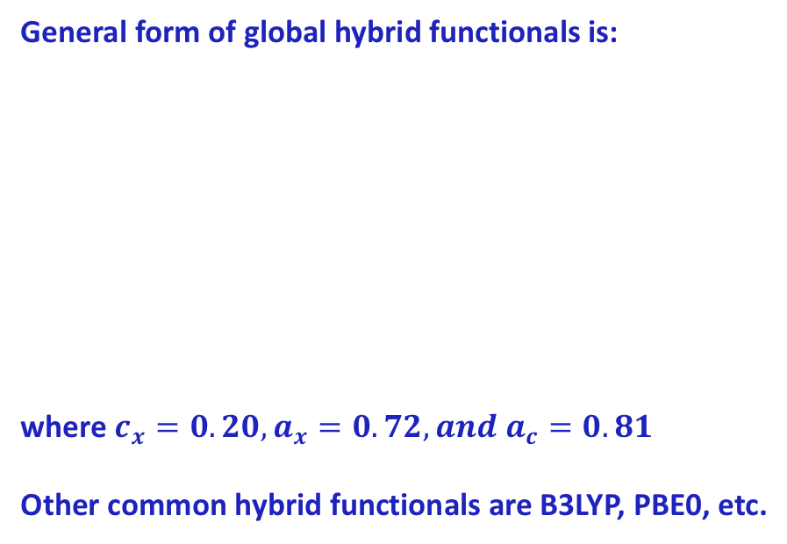
Hybrid GGA, meta GGA
General form of global hybrid functionals is:
where $c_{x}=0.20,a_{x}=0.72,and a_{c}=0.81$
Other common hybrid functionals are B3LYP, PBE0, etc.
B3LYP
Burke, J. Chem. Phys., 136, 150901, 2018
Mardirossian and Head-Gordon, Mol. Phys., 115, 2315-2372, 2017
neerajrai@che.msstate.edu

Slide 9
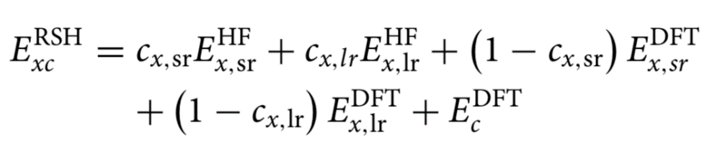
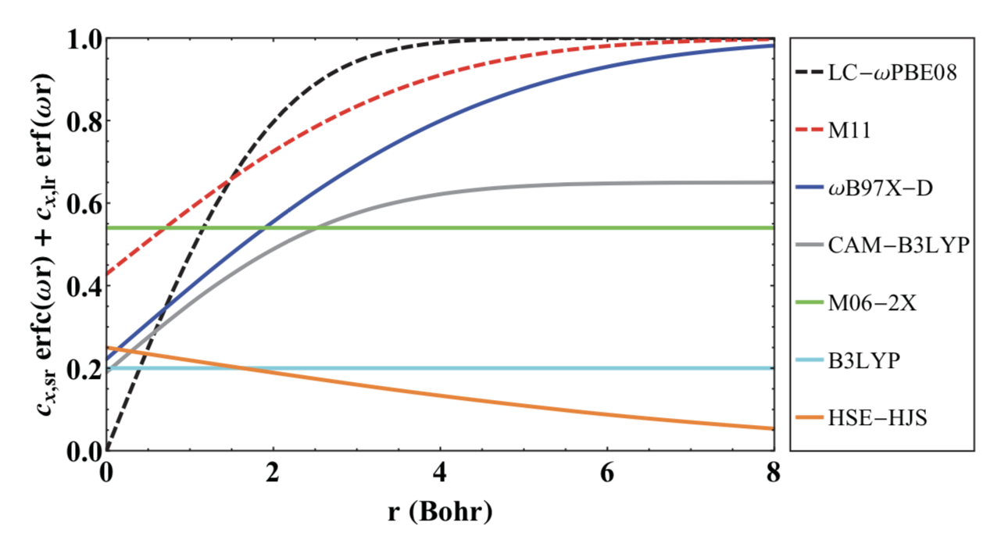
Range separated functionals
Range separated functionals attempt to address self-interaction error and are given by the following form:
Common examples include: ωB97, ωB97X, LRC-ωPBE, etc.
Mardirossian and Head-Gordon, Mol. Phys., 115, 2315-2372, 2017
neerajrai@che.msstate.edu

Slide 10
Another short coming of DFT functionals is the inability to capture vdW interactions
Grimme, Comput. Mol. Sci., 1, 211-228, 2011
neerajrai@che.msstate.edu

Slide 11
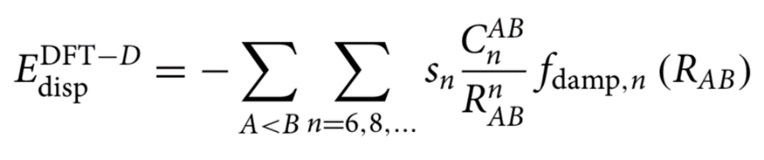
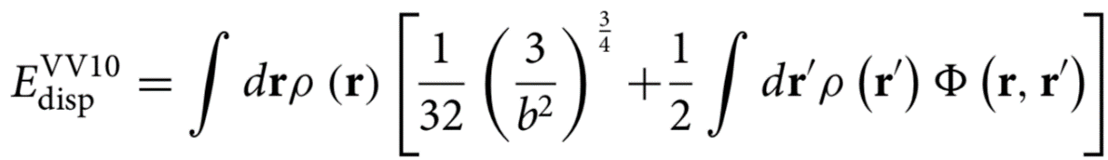
Dispersion-corrected/nonlocal density functionals
Grimme’s dispersion correction model:
Nonlocal density functionals
Mardirossian and Head-Gordon, Mol. Phys., 115, 2315-2372, 2017
neerajrai@che.msstate.edu

Slide 12
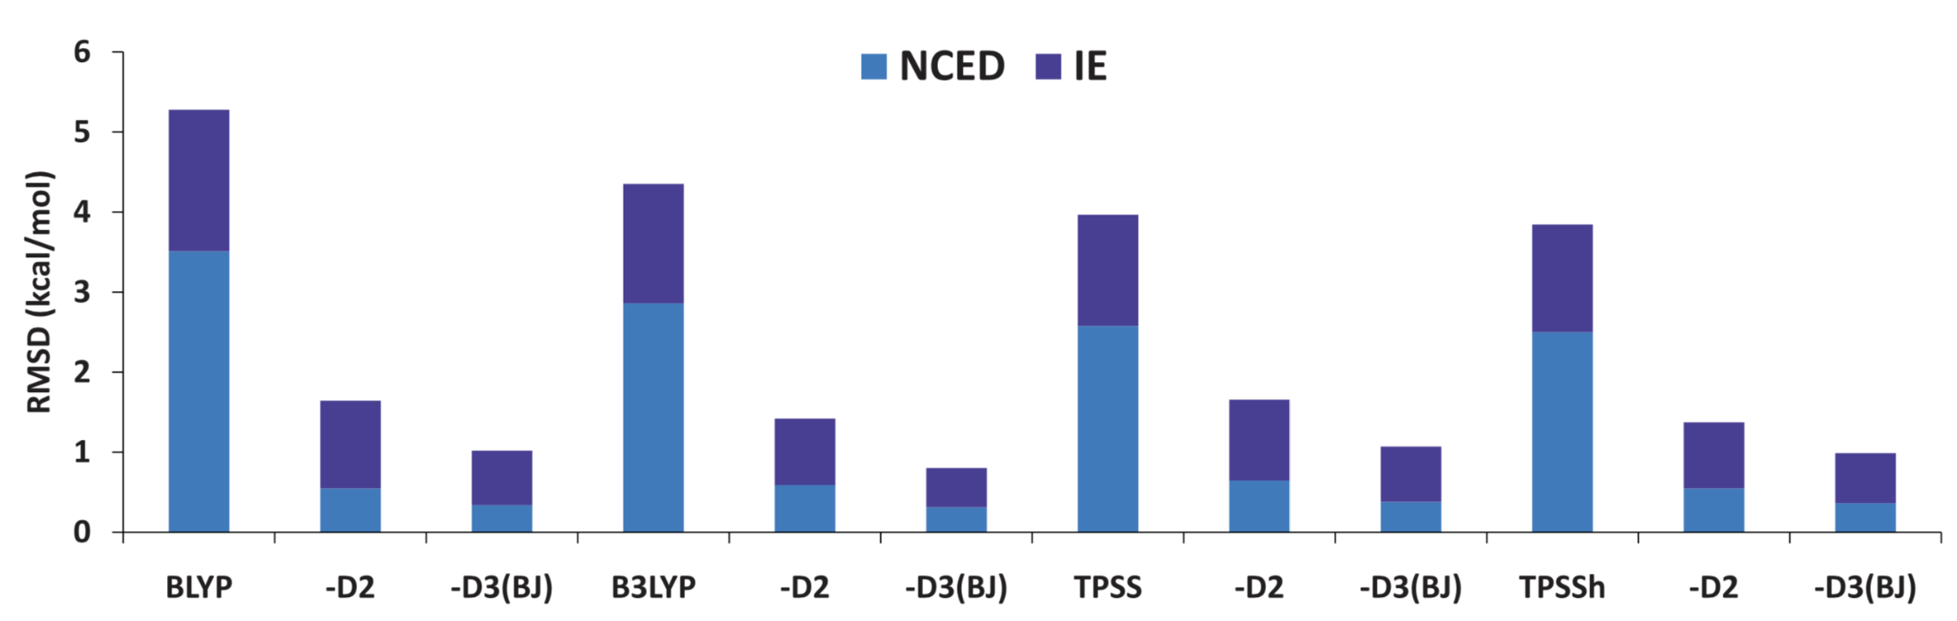
Accuracy of different dispersion correction models
Mardirossian and Head-Gordon, Mol. Phys., 115, 2315-2372, 2017
neerajrai@che.msstate.edu

Slide 13
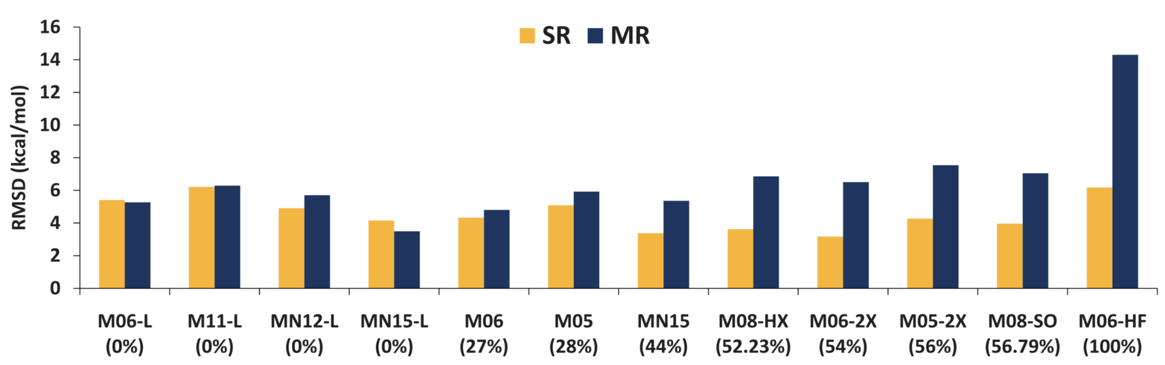
General accuracy for selected MN functionals for atomization energies bond dissociation
Mardirossian and Head-Gordon, Mol. Phys., 115, 2315-2372, 2017
neerajrai@che.msstate.edu

Slide 14
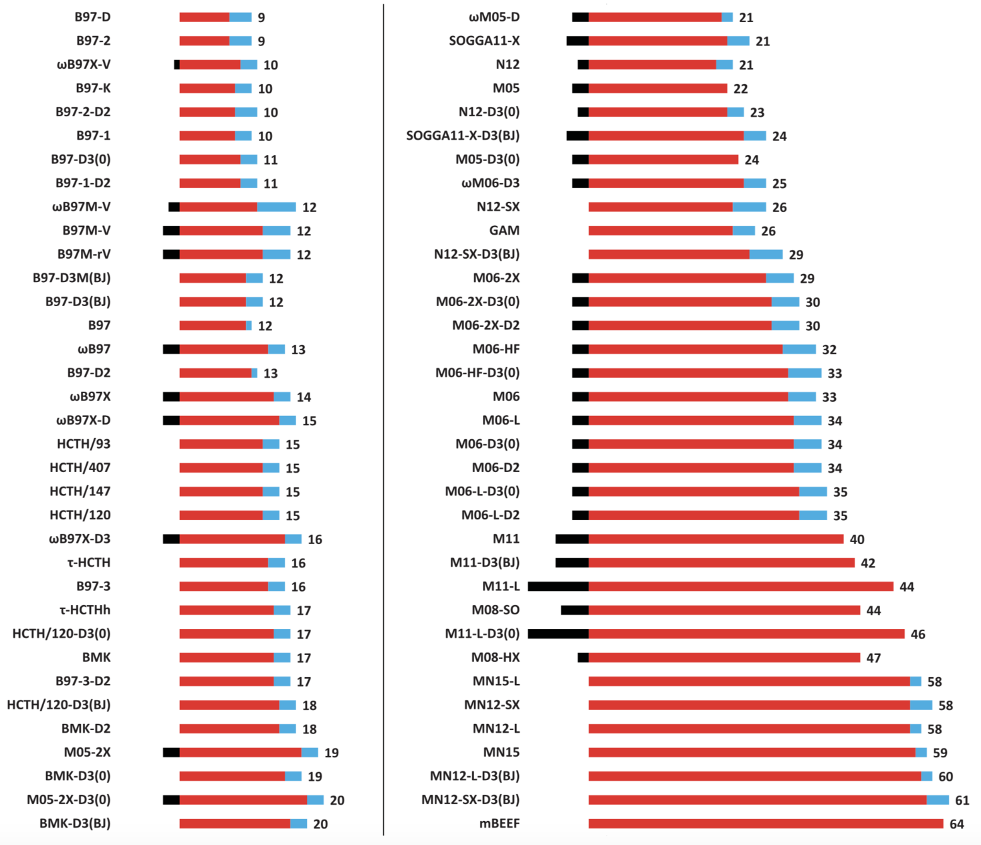
Number of parameters in different density functionals
Mardirossian and Head-Gordon, Mol. Phys., 115, 2315-2372, 2017
neerajrai@che.msstate.edu

Slide 15
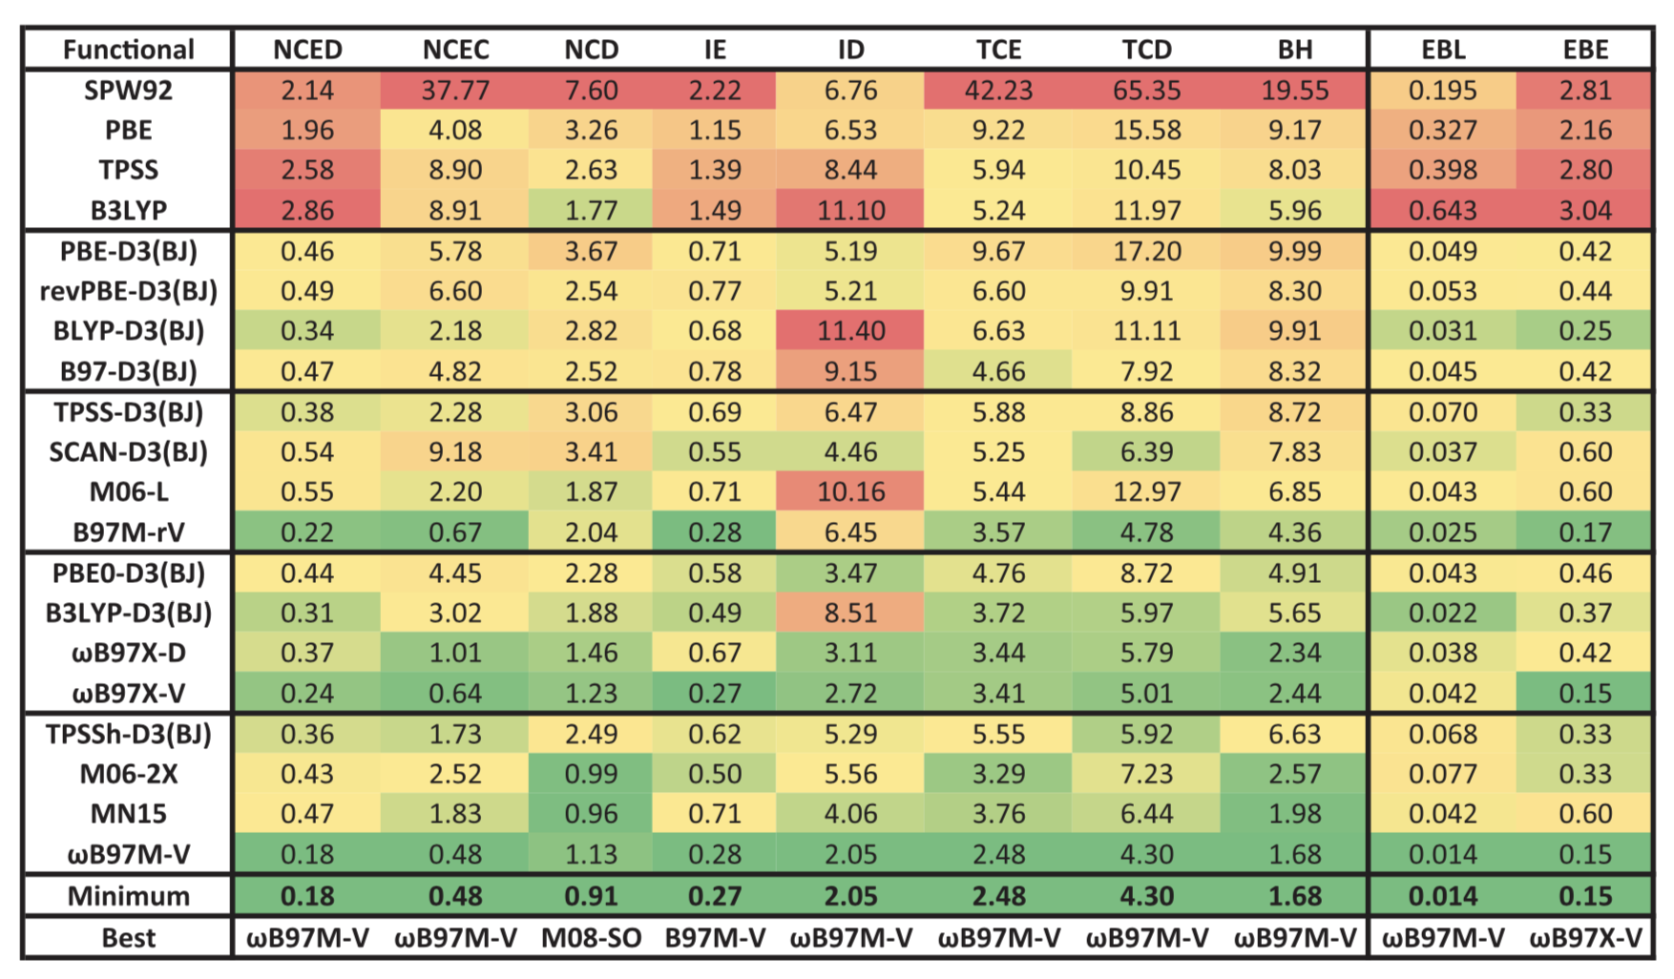
Accuracy of functionals for bond lengths and binding energies
Mardirossian and Head-Gordon, Mol. Phys., 115, 2315-2372, 2017
neerajrai@che.msstate.edu

Slide 16
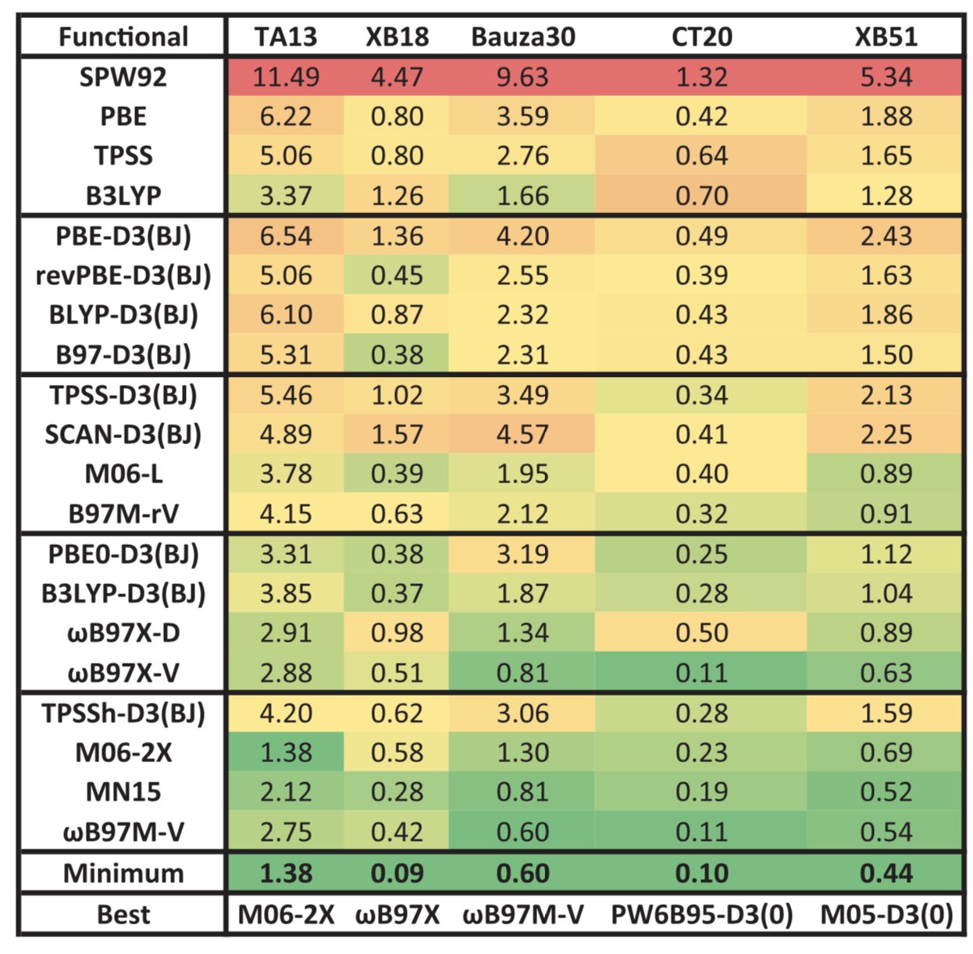
Open-shell non-covalent or dimers characterized by significant electron delocalization
Mardirossian and Head-Gordon, Mol. Phys., 115, 2315-2372, 2017
neerajrai@che.msstate.edu

Slide 17
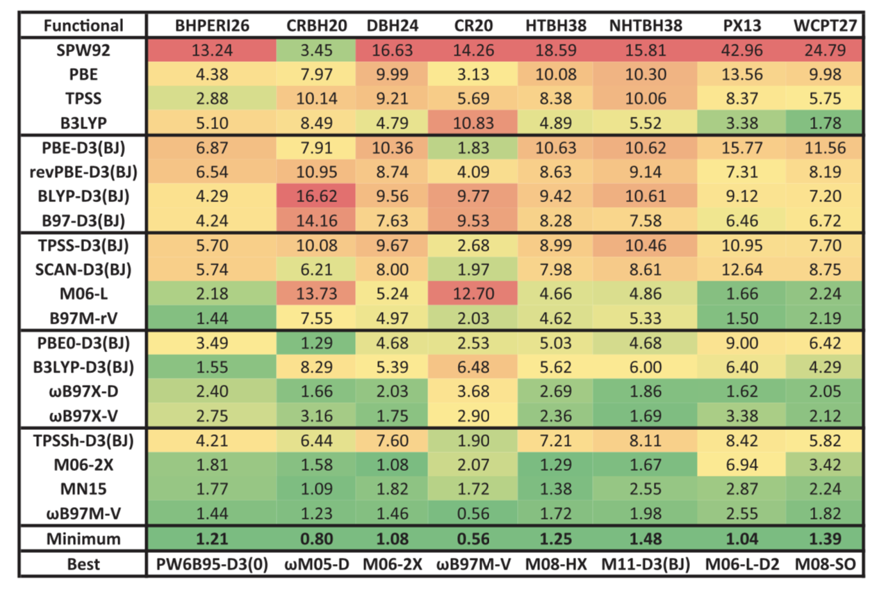
Barrier heights
Mardirossian and Head-Gordon, Mol. Phys., 115, 2315-2372, 2017
neerajrai@che.msstate.edu

Slide 18
How does a beginning user decide what XC functionals to use – likely without understanding the underlying physics/math of why one might be better or worse for a given situation?
neerajrai@che.msstate.edu

Slide 19
How does a beginning user decide what XC functionals to use – likely without understanding the underlying physics/math of why one might be better or worse for a given situation?
-Ask a physicist/QM developer/expert what might work for your new system/material that no one has ever thought about modeling with QM before
-Look at empirical testing of what has been done on your system or something most similar (ie, has someone gotten the same types of values you want for a similar system and shown a functional that worked well enough)
-Look at what others have used (without perfect validation and possibly unknown error) and be conscious of lack of certainty in conclusions you are reaching…..
neerajrai@che.msstate.edu

Slide 20
Questions?
neerajrai@che.msstate.edu

